Slide 1

SudhaarNow
Transforming civic engagement through transparency, gamification, and accountability

Slide 2

The Problem
Citizens Face Barriers
Authorities Struggle
No way to track reported issues
Lost complaints in manual systems
Cumbersome reporting process
No centralized dashboard
Lack of prioritization tools
Zero incentive to participate
Inefficient resource allocation
Fragmented communication channels

Slide 3




Our Solution
Easy Reporting
Real-Time Tracking
Upload photos, pin location, select category—all in under 60 seconds.
Monitor issue status from submission to resolution with instant notifications.
Gamified Engagement
Public Transparency
Earn points, unlock badges, and climb leaderboards for civic contributions.
View all issues and resolutions on an open community wall.

Slide 4
Success Metrics
80%
10K
<12h
4.5/5
Resolution Rate
Active Users
First Update
Satisfaction
Issues resolved within 14 days (6-month target)
Monthly reporting citizens (6-month target)
Time to initial status change (3-month target)
In-app user satisfaction score (6-month target)

Slide 5
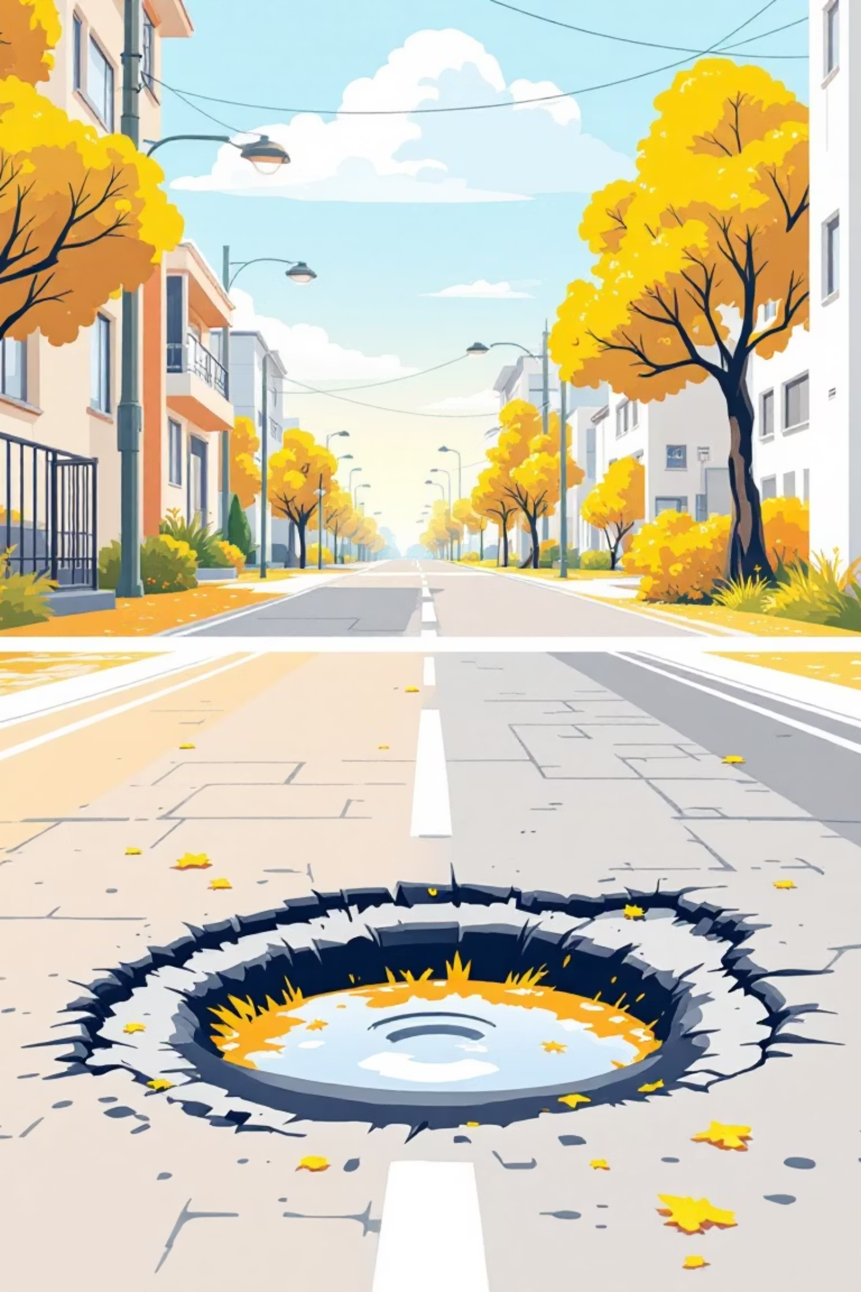
Citizen Journey: From Report to Resolution
1
Report Issue
Citizen submits complaint with photo and location. +10 points earned.
2
Authority Reviews
Status changes to "In Progress" with estimated resolution date. Notification sent.
3
Issue Resolved
Authority uploads resolution photo. Citizen earns +20 points and badge progress.
4
Recognition
Citizen climbs leaderboard, unlocks new badge tier, and feels motivated to continue.

Slide 6





Gamification System & Badges
Point System
Starter
Active
+10 Valid report submitted
First report submitted
5+ resolved issues
+20 Issue resolved
-15 Fake/spam report
Real-time leaderboard tracks top contributors weekly, monthly, and all-time.
Champion
Hero
20+ resolved issues
50+ resolved issues
Legend
100+ resolved issues

Slide 7
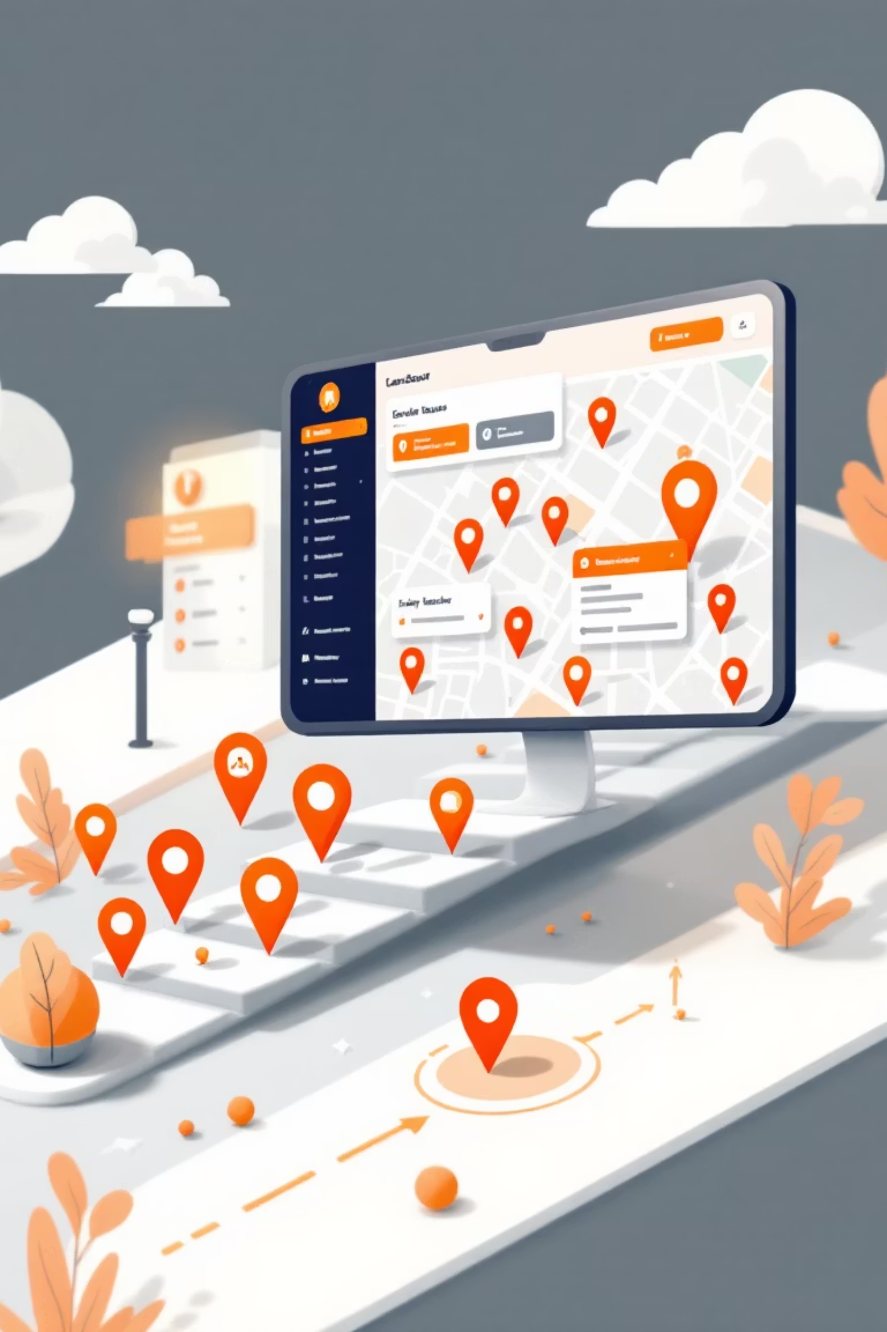
Authority Dashboard
Centralized View
Status Management
All complaints in one dashboard, filterable by status, category, and location.
Update issues from Pending → In Progress → Resolved with resolution photos.
Spam Control
Mark fake reports to maintain data quality and penalize abuse.

Slide 8
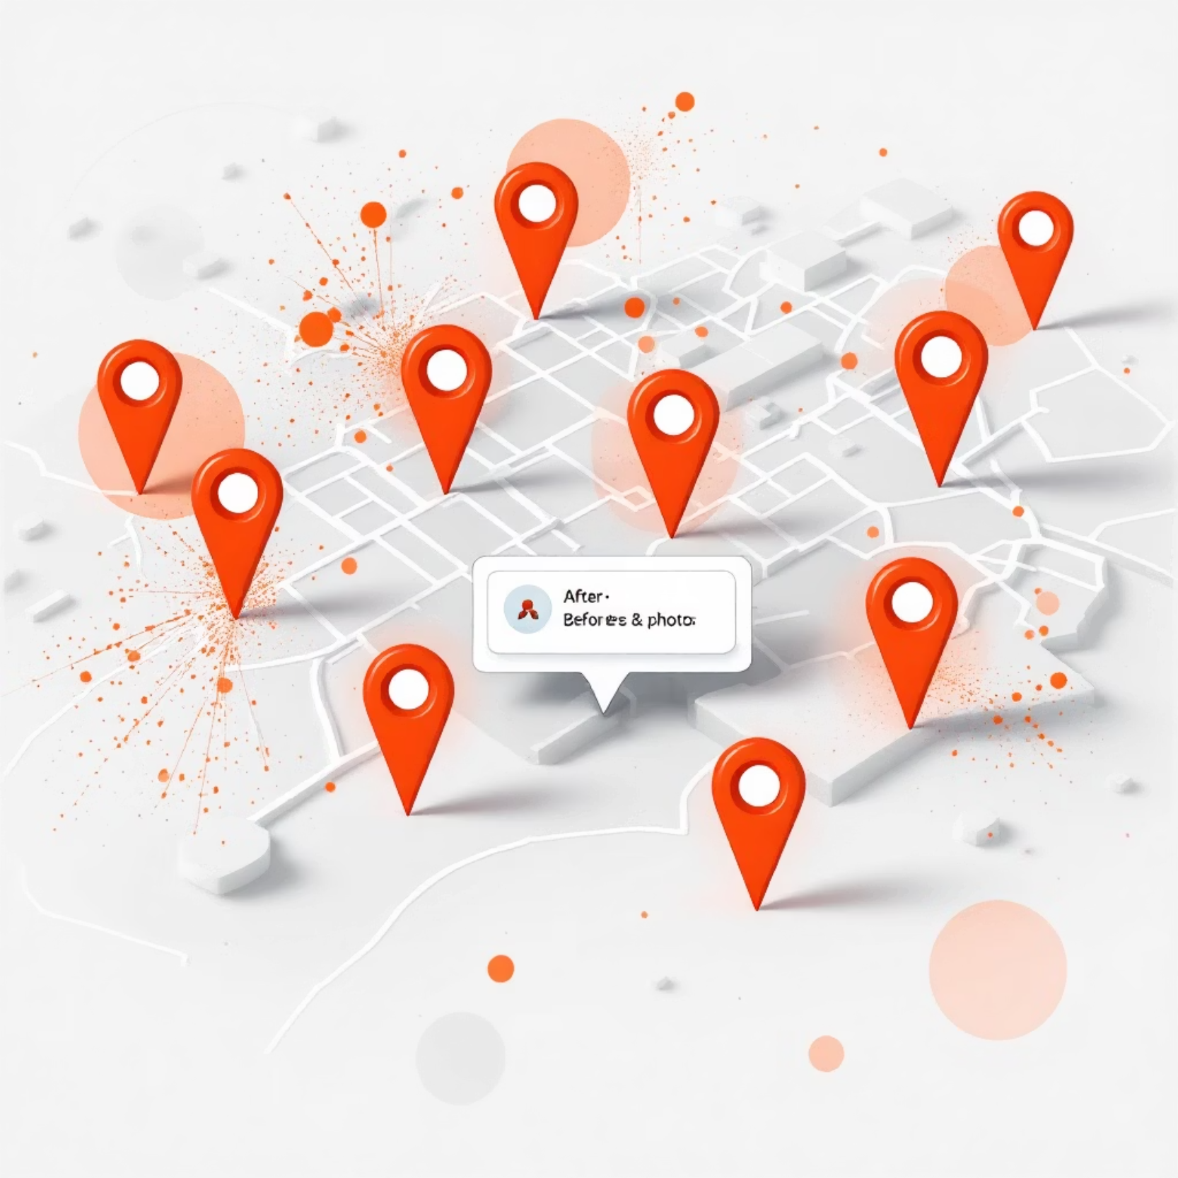
Public Transparency Wall
Community Impact
Publicly accessible map and list showing all reported issues with:
Original and resolution photos
Issue type and location
Resolution date and time
System-wide analytics
Achievement Board showcases top contributors, building community pride and trust.

Slide 9
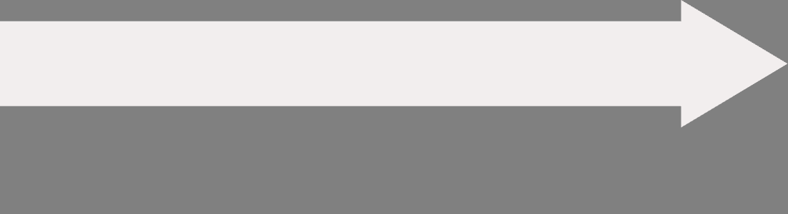
Implementation Roadmap
Phase 3: Advanced Features
Phase 2: Public Launch
Chatbot integration, advanced analytics, municipal system integration, and user upvoting.
Phase 1: MVP
Full dashboard, transparency wall, notifications, complete gamification (badges, leaderboard, +20 points).
Core reporting, basic authority dashboard, issue tracking, and foundational gamification (+10/-15 points).

Slide 10


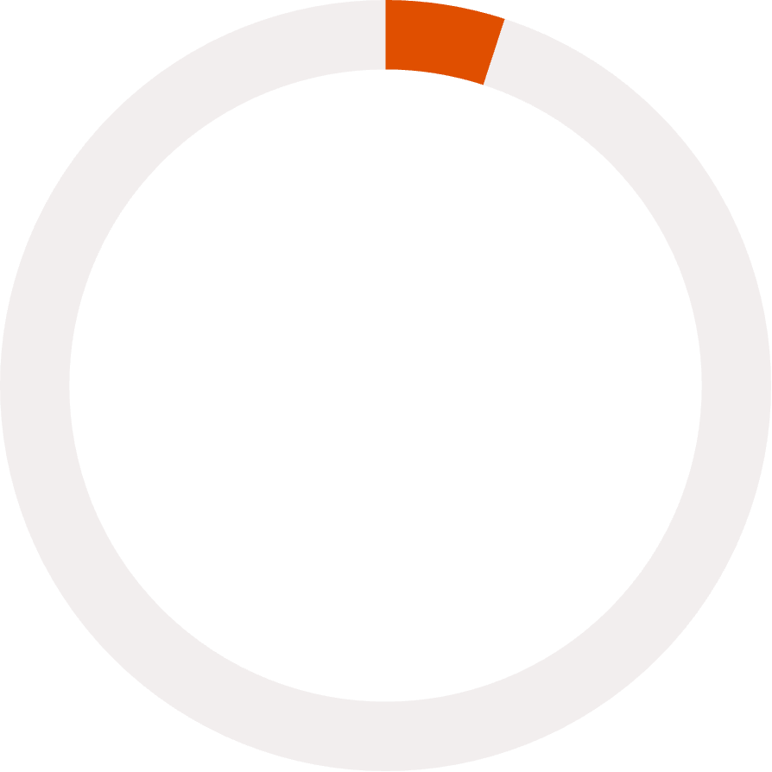
Building Trust Through Technology
80%
25%
<5%
Resolution Rate
Badge Progression
Spam Reports
Target within 6 months
Users reaching Active tier
Maintained through penalties
SudhaarNow transforms civic participation from frustration to empowerment. By combining transparency, gamification, and accountability, we're creating a platform where every citizen becomes a champion for their community.

Slide 11
THANK YOU!!!!

